Slide 1
Marketing

Slide 2
Distribution channels in marketing

Slide 3

Distribution Channel
A distribution channel is the network of businesses or intermediaries through which a good or service passes until it reaches the final buyer (the end consumer). Distribution channels can include wholesalers, retailers, distributors, and the Internet.

Slide 4

Conventional distribution channels
A channel consisting of one or more independent producers, wholesalers, and retailers, each a separate business seeking to maximize its own profits, perhaps even at the expense of profits for the system as a whole.

Slide 5
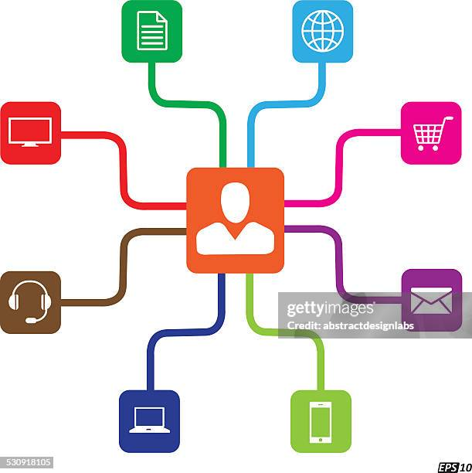
Vertical marketing system
Vertical marketing system (VMS) A channel structure in which producers, wholesalers, and retailers act as a unified system. One channel member owns the others, has contracts with them, or has so much power that they all cooperate.

Slide 6
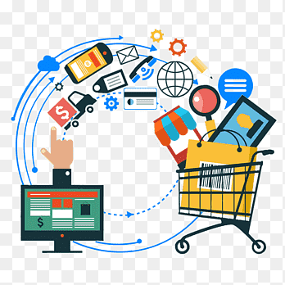
VMS
A vertical marketing system that combines successive stages of production and distribution under single ownership-channel leadership is established through common ownership.
Contractual VMS: A vertical marketing system in which independent firms at different levels of production and distribution join together through contracts.

Slide 7
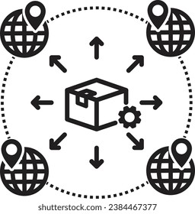
Marketing channel design
Designing the marketing channel starts with finding out what target consumers want from the channel.
It begins with analyzing customer needs, setting channel objectives, identifying major channel alternatives, and evaluating those alternatives.
Do consumers want to buy nearby, or are they willing to travel to more centralized locations?
Would customers rather buy in person, by phone, or online?
Do consumers want many add-on services (delivery, installation, repairs), or will they obtain these services elsewhere?

Slide 8
Identifying Major Alternatives
When the company has defined its channel objectives, it should next identify its major channel alternatives in terms of the types of intermediaries, the number of intermediaries, and the responsibilities of each channel member.
Types of Intermediaries:
Intensive distribution: Stocking the product in as many outlets as possible.
Exclusive distribution: Giving a limited number of dealers the exclusive right to distribute the company’s products in their territories.
Selective distribution: The use of more than one but fewer than all of the intermediaries that are willing to carry the company’s products

Slide 9
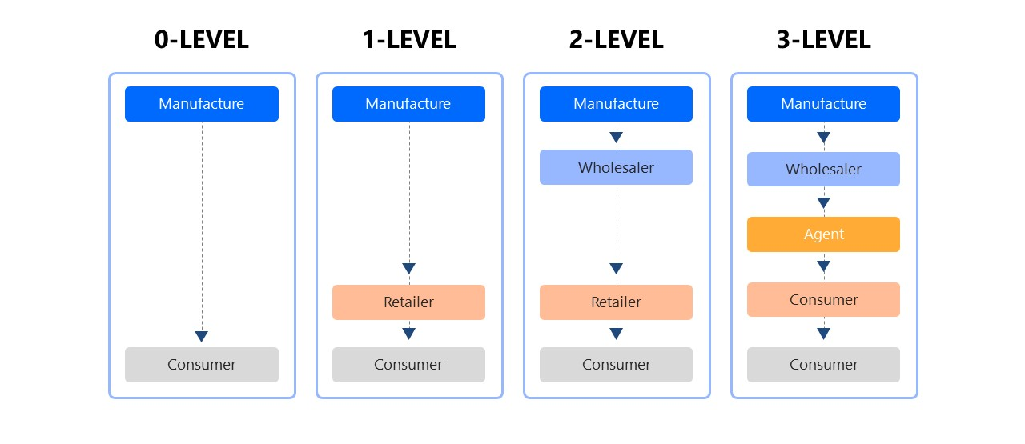

Slide 10
Terms to know
Wholesaling: All the activities involved in selling goods and services to those buying for resale or business use.
Wholesaler: A firm engaged primarily in wholesaling activities.
Retailing: All the activities involved in selling goods or services directly to final consumers for their personal, nonbusiness use.
Retailer: A business whose sales come primarily from retailing.
Agent: A wholesaler who represents buyers or sellers on a relatively permanent basis, performs only a few functions, and does not take title to goods.
Broker: A wholesaler who does not take title to goods and whose function is to bring buyers and sellers together and assist in negotiation.

